Slide 1
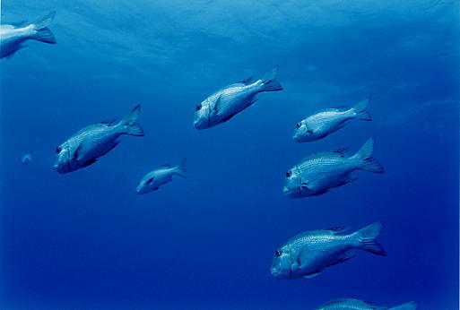
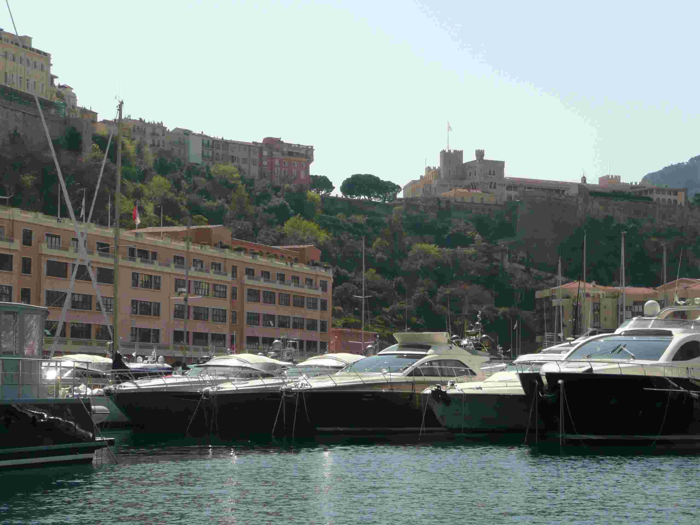

Protecting the Environment
David Osborn
Environment Laboratories

Slide 2
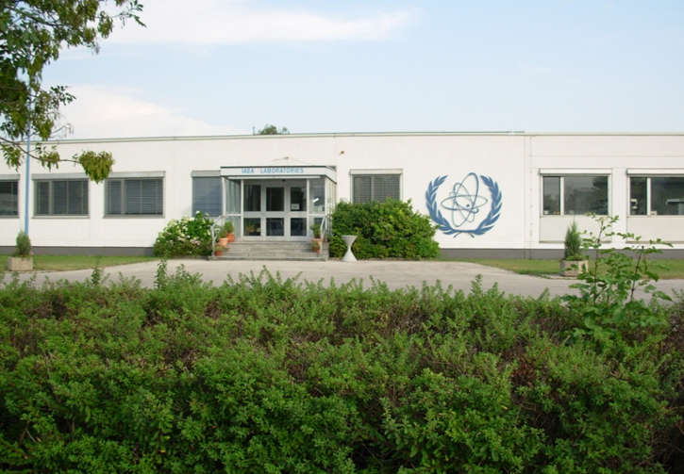

Slide 3
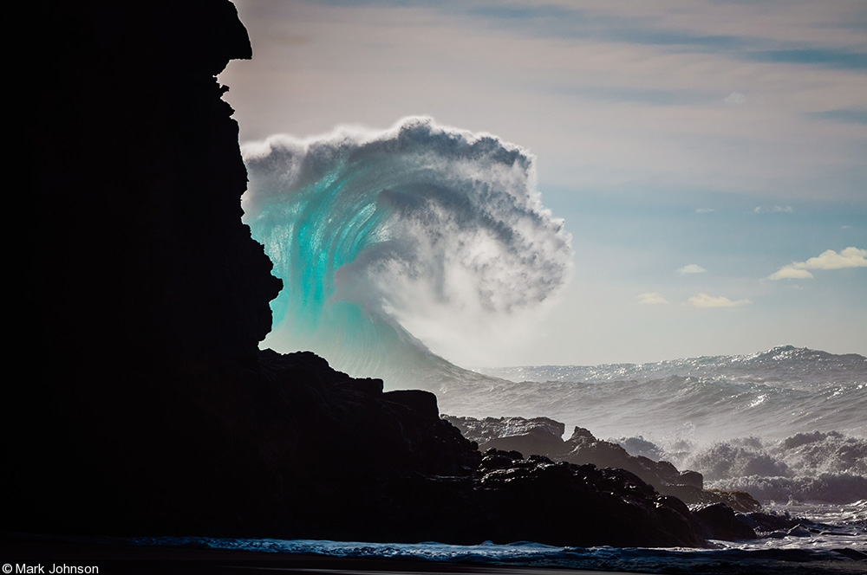

Slide 4
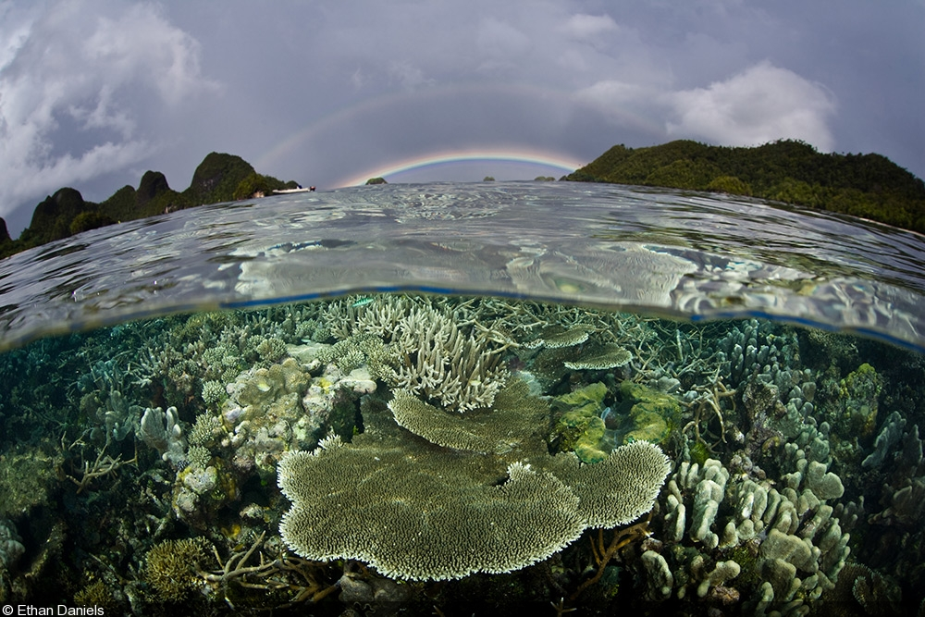

Slide 5
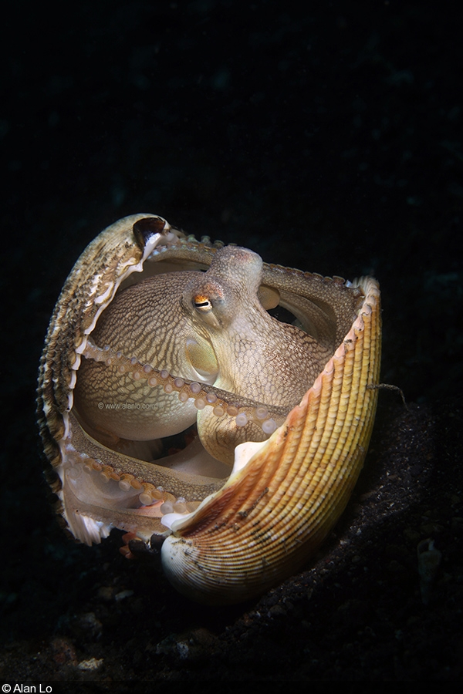
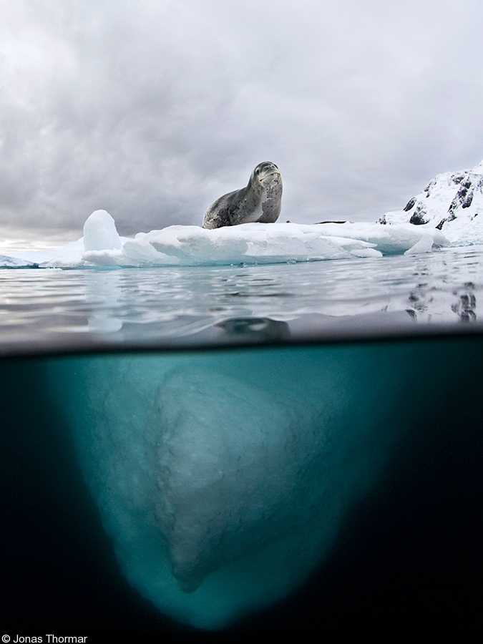

Slide 6
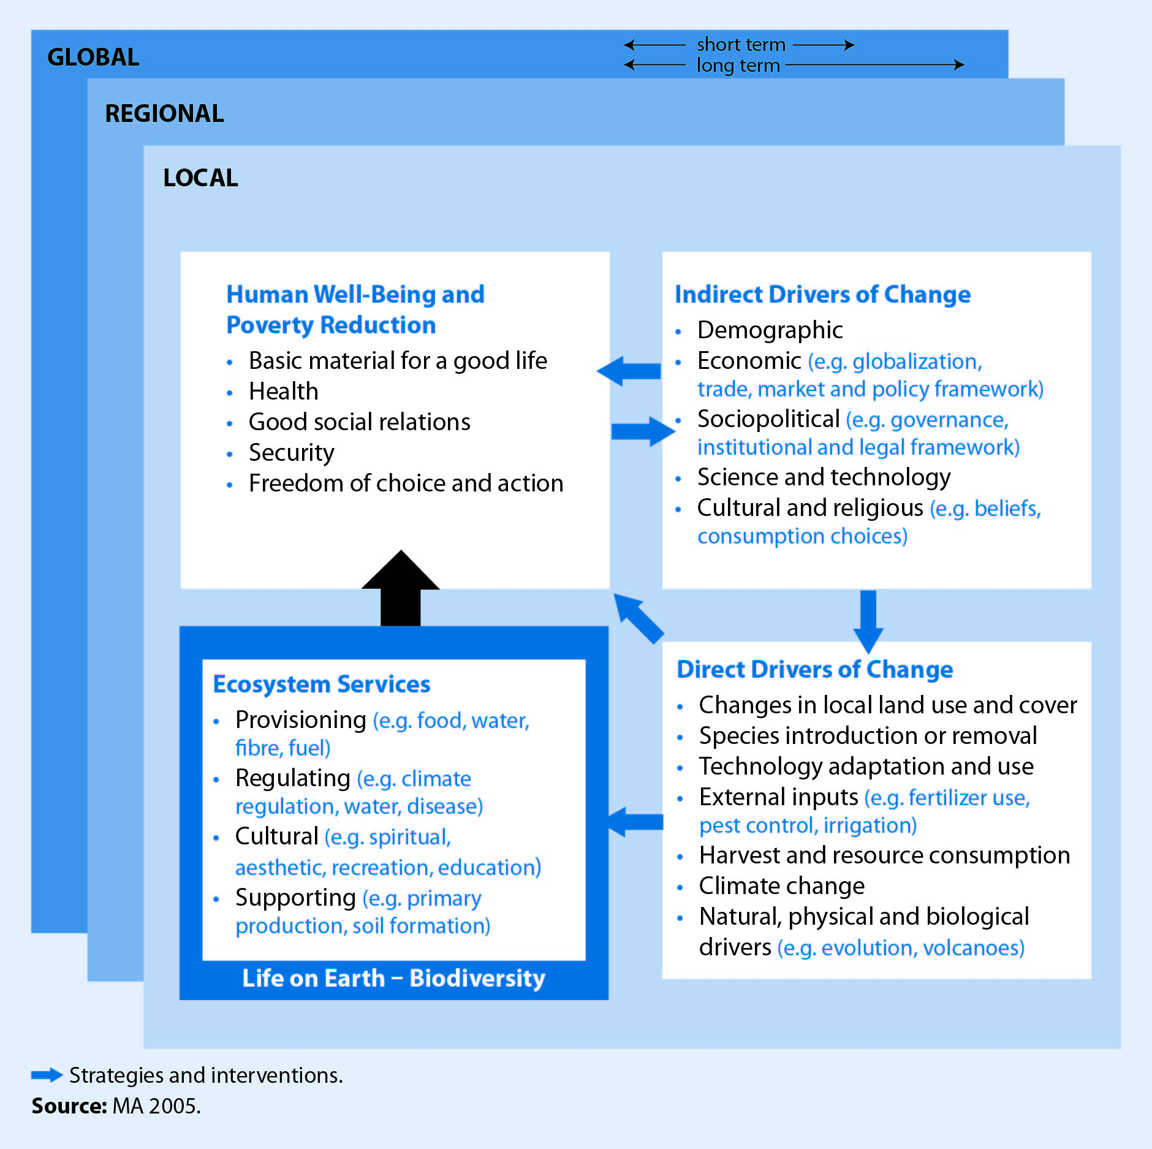

Slide 7
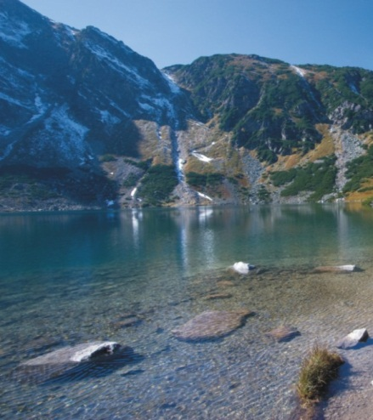

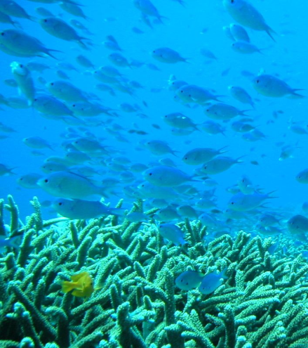
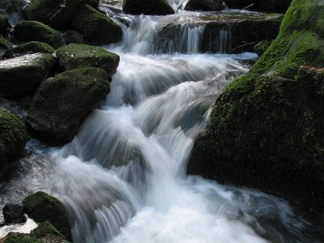
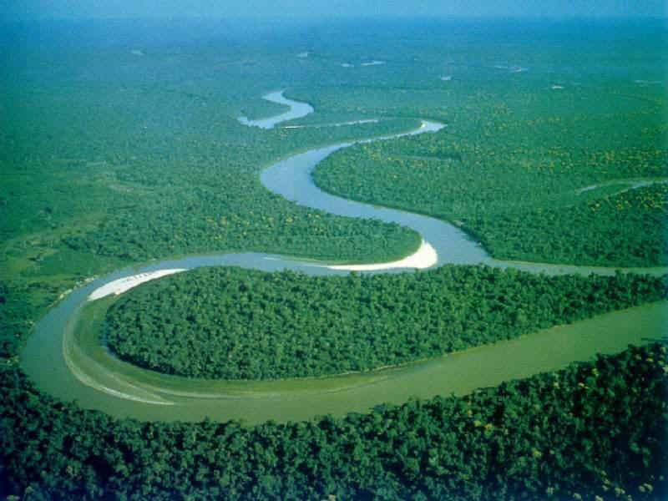
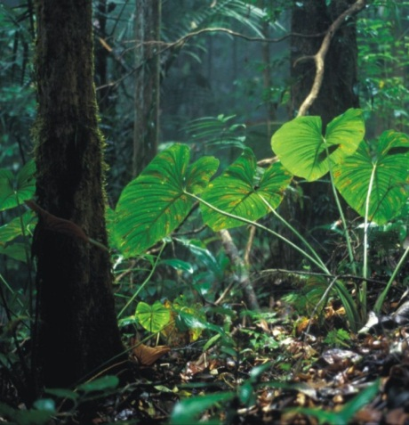
The Environment - our future depends on it

Slide 8
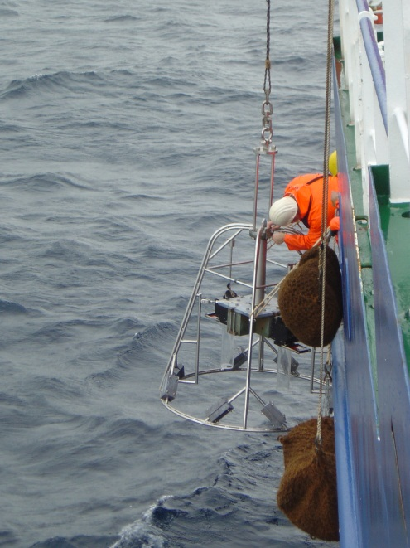
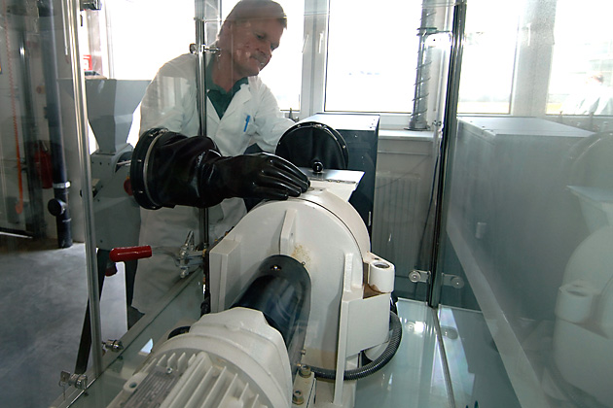
Understanding the environment applying isotopic and nuclear techniques
Nuclides and isotopes can be used as a tool
to study environmental processes in time and space;
to study pollution and its temporal evolution;
to recognise and identify polluters by its typical isotopic pattern;
to contribute to climate change studies;
to conduct radio-ecological studies and assessments.
Notes:
8

Slide 9
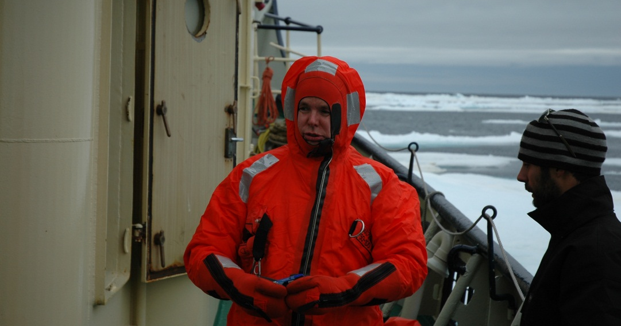
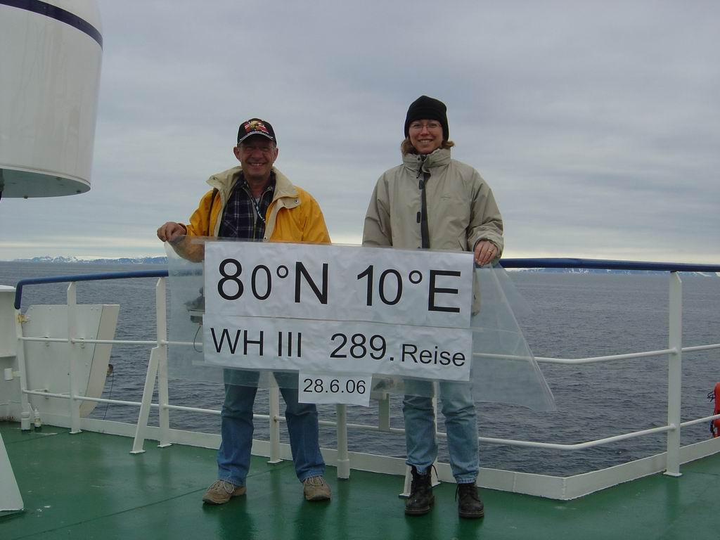

Slide 10
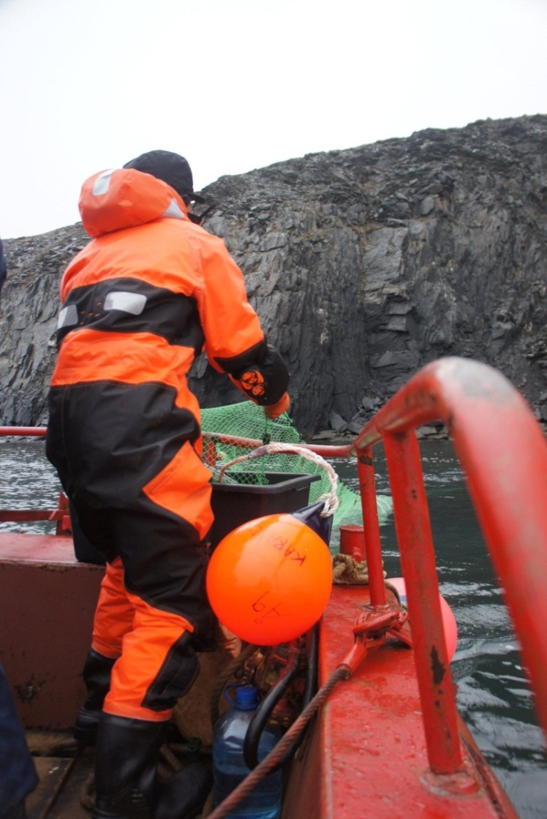
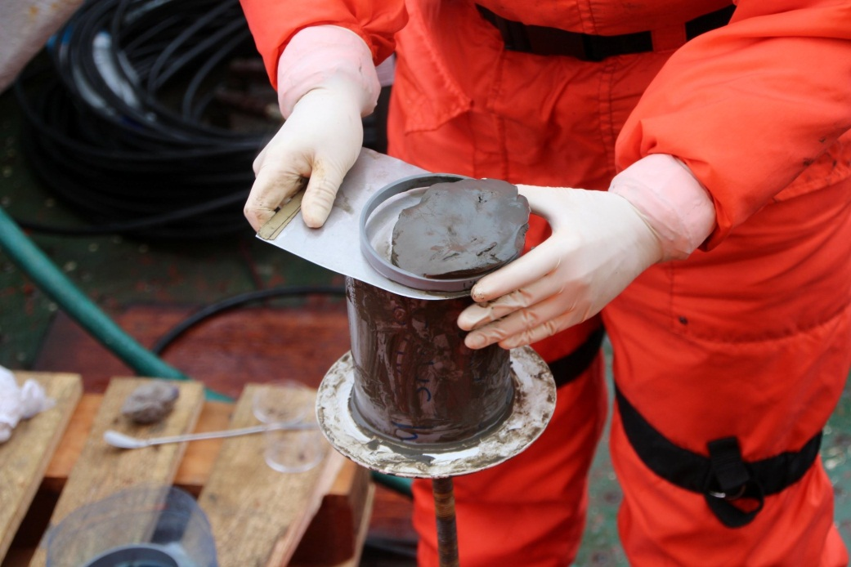
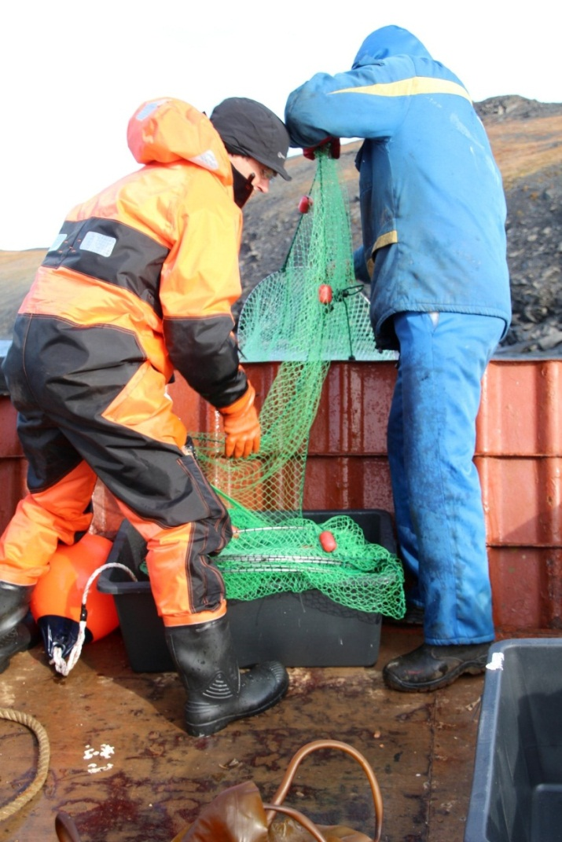

Slide 11
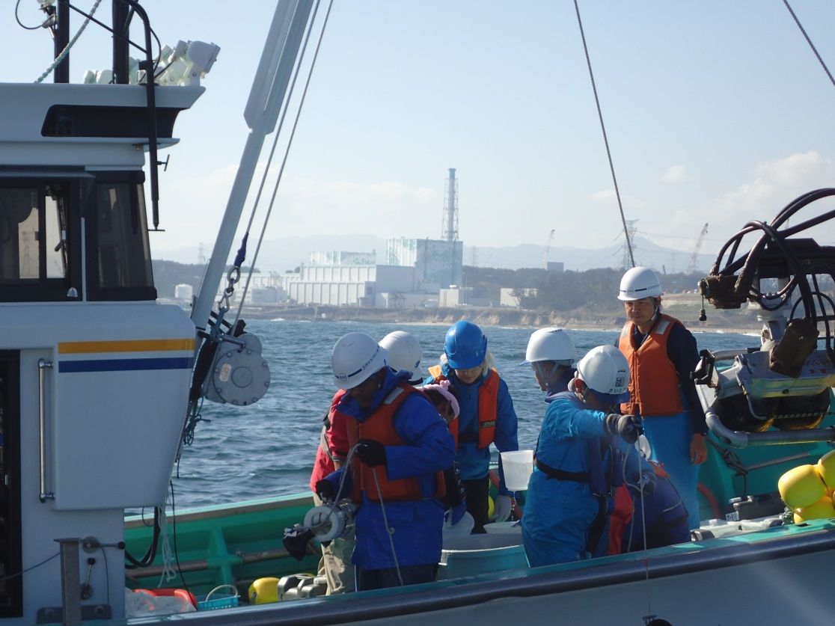
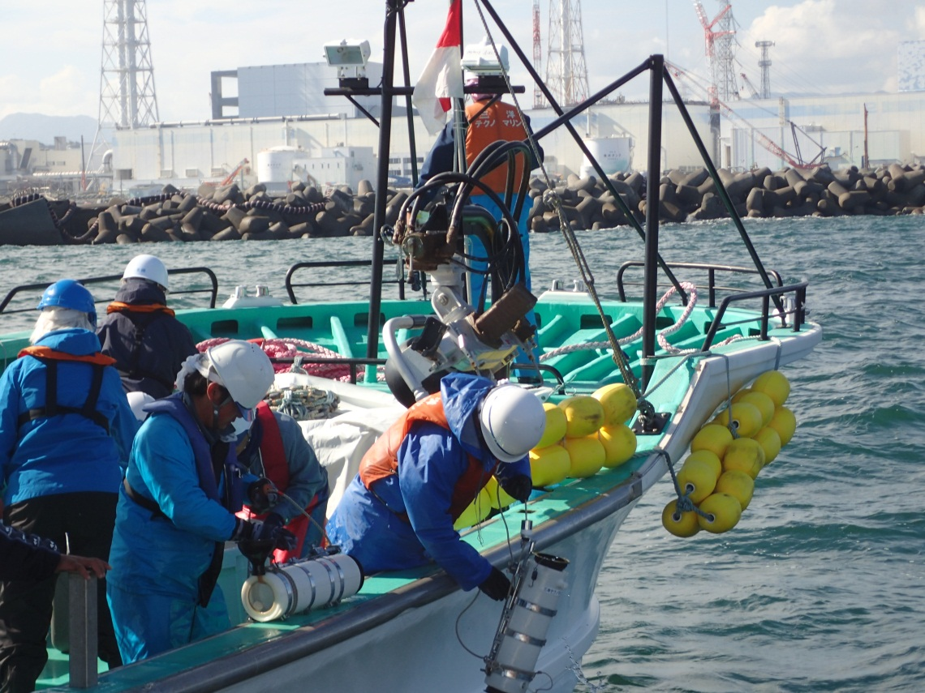

Slide 12
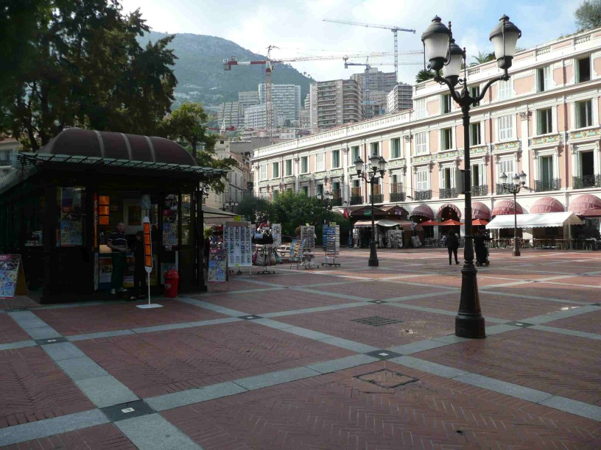
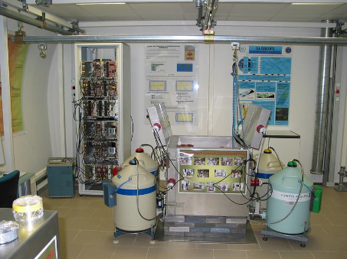
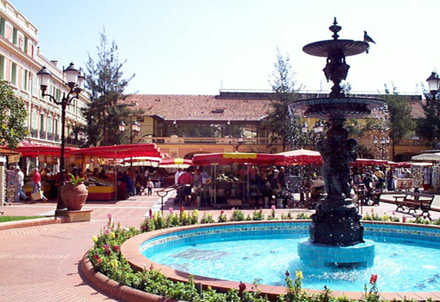
Environment Laboratories Analytical Facilities
Underground (11 m below surface) Gamma- Spectrometer (7)
30 m water-equivalent due to the „low-level“ rock
Notes:
REL's aquaria have a total capacity of 8000 L under running sea water system. The seawater is pumped into the laboratory from the front of Monaco bay at 30-meter's depth, 500 meter from the laboratory at a flux rate of 7000L per hour Tropical, temperate and artic ecosystem are recreated in specific tanks where the principal seawater parameters such as temperature, salinity, dissolved oxygen pH are permanently controlled and registered

Slide 13
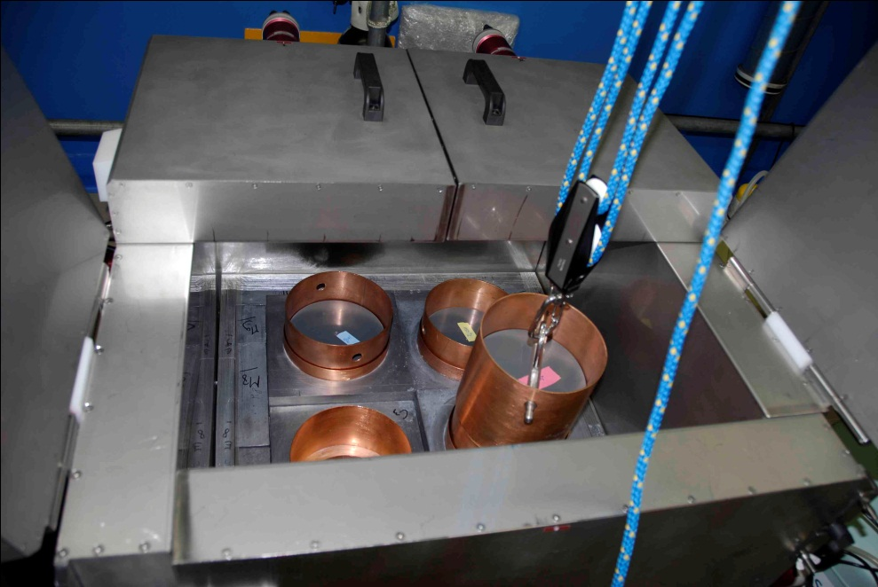
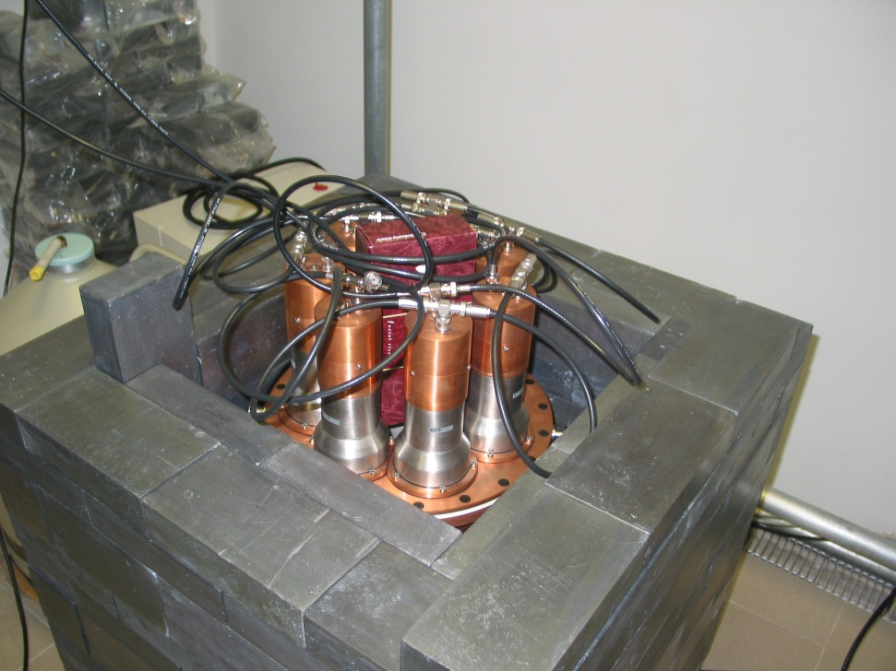
EL Analytical Facilities
Active Shielding for
- cosmic rays (plastic Scintillators around the detectors)
Internal Compton shielding (NaI-Crystals)

Slide 14
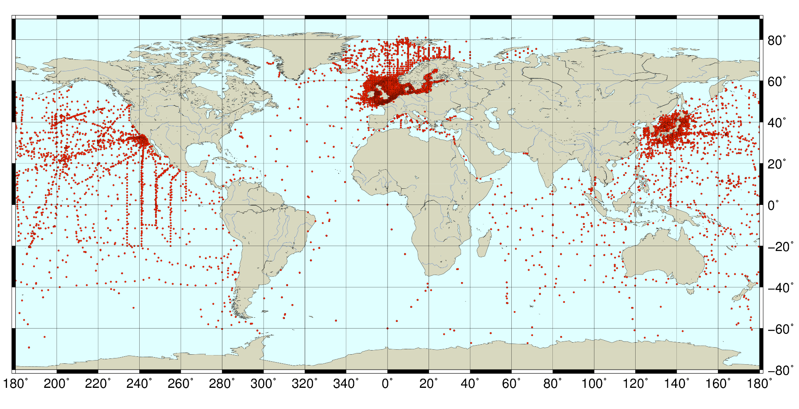
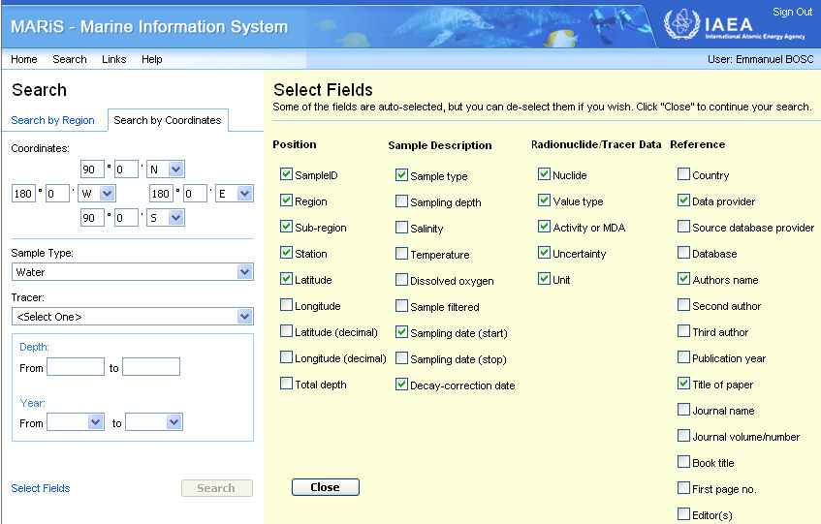
On-line access to world-wide marine radioactivity data
110 000 data
94 radionuclide
30 years
339 laboratories
http://maris.iaea.org/
Notes:
Through the IAEA’s NUCLEUS portal for nuclear knowledge and information (http://nucleus.iaea.org) one can access the MARIS database (http://maris.iaea.org), which contains over 110,000 data on radionuclide levels in the marine environment. The main objective of this database is to provide easy access to a large volume of marine radioactivity data.

Slide 15
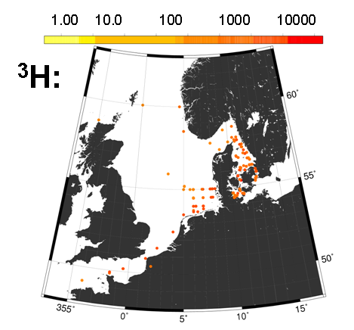
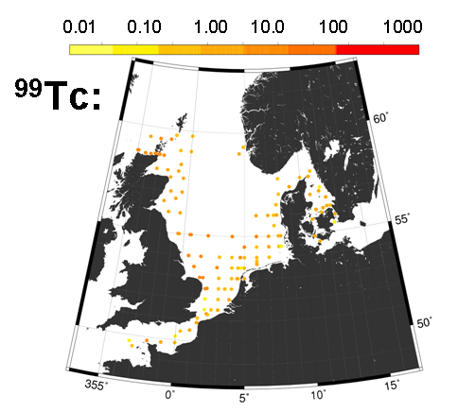
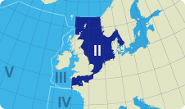
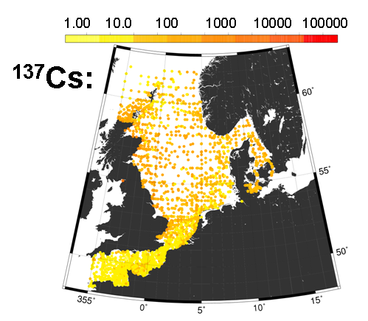
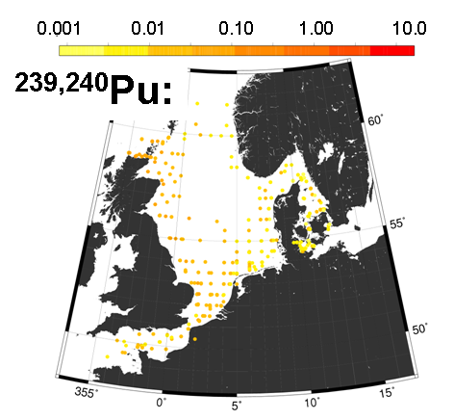
Some data from OSPAR Region II
OSPAR Region II

Slide 16
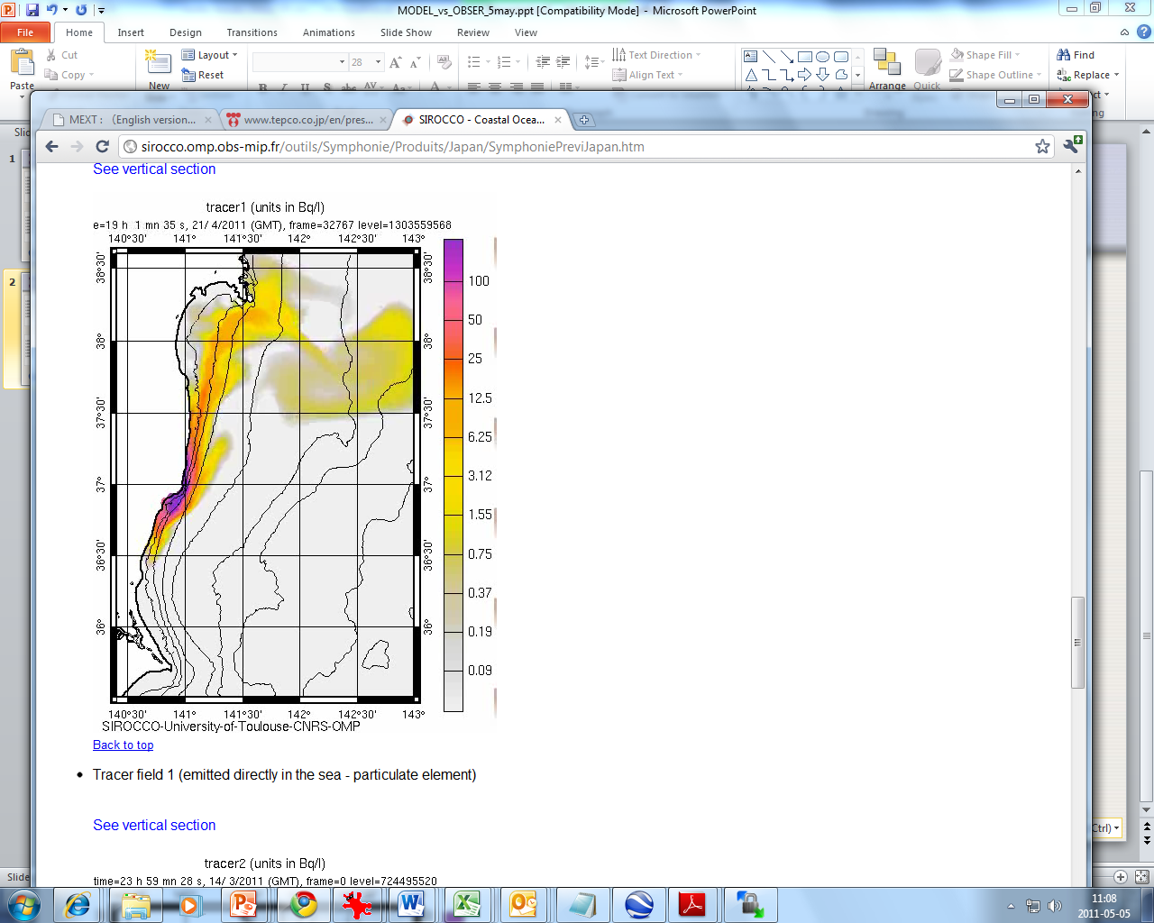
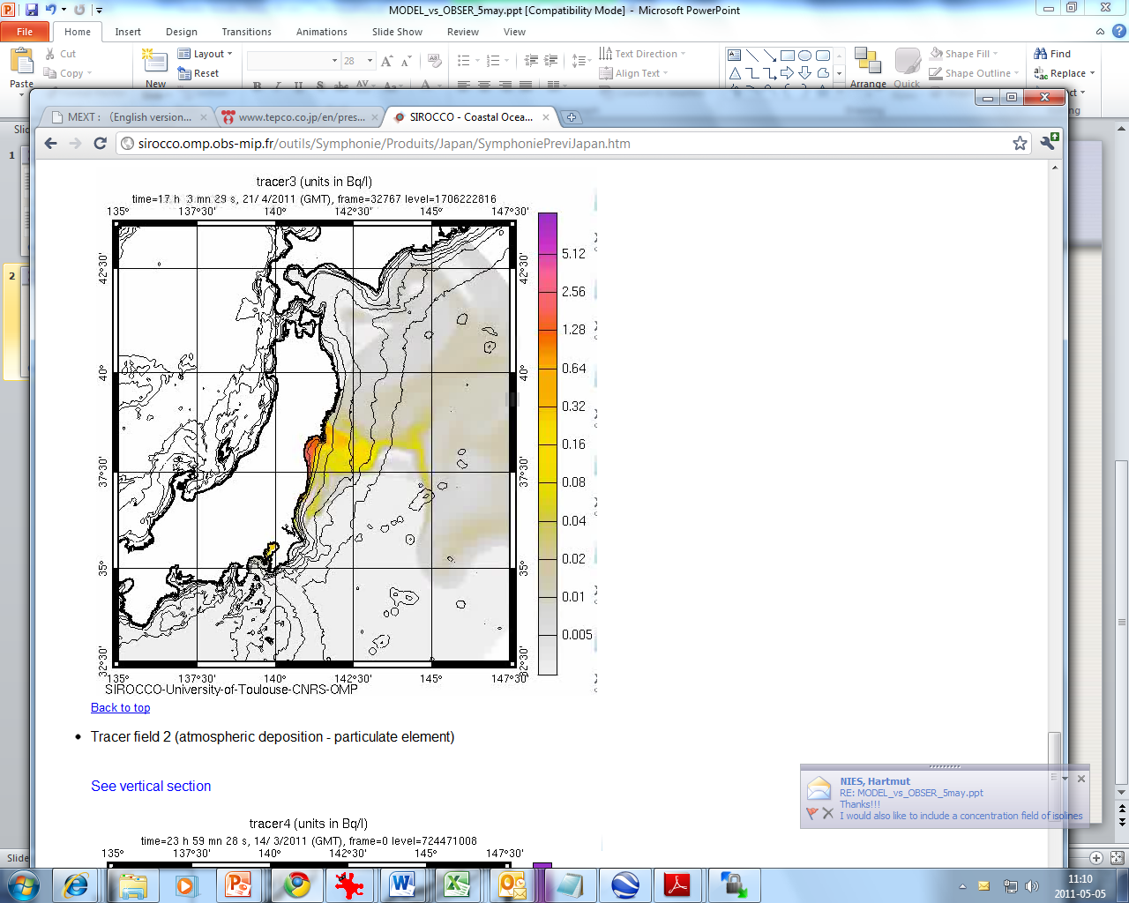
Ocean modelling
Liquid release simulation
Atmospheric deposition simulation

Slide 17
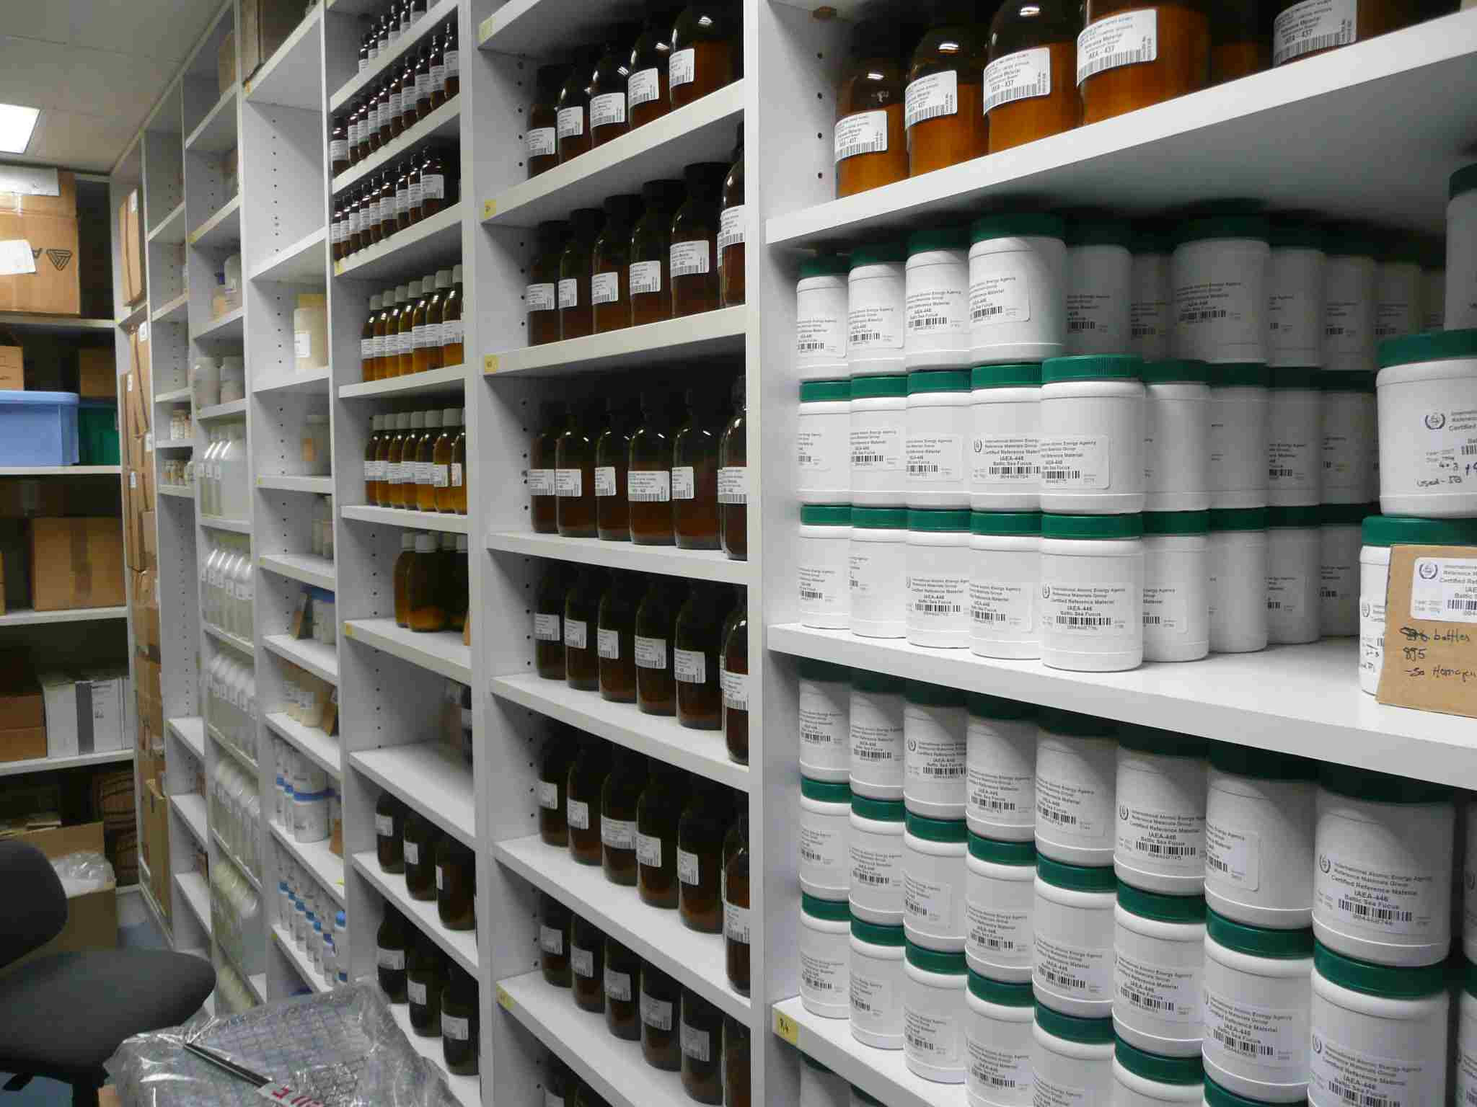
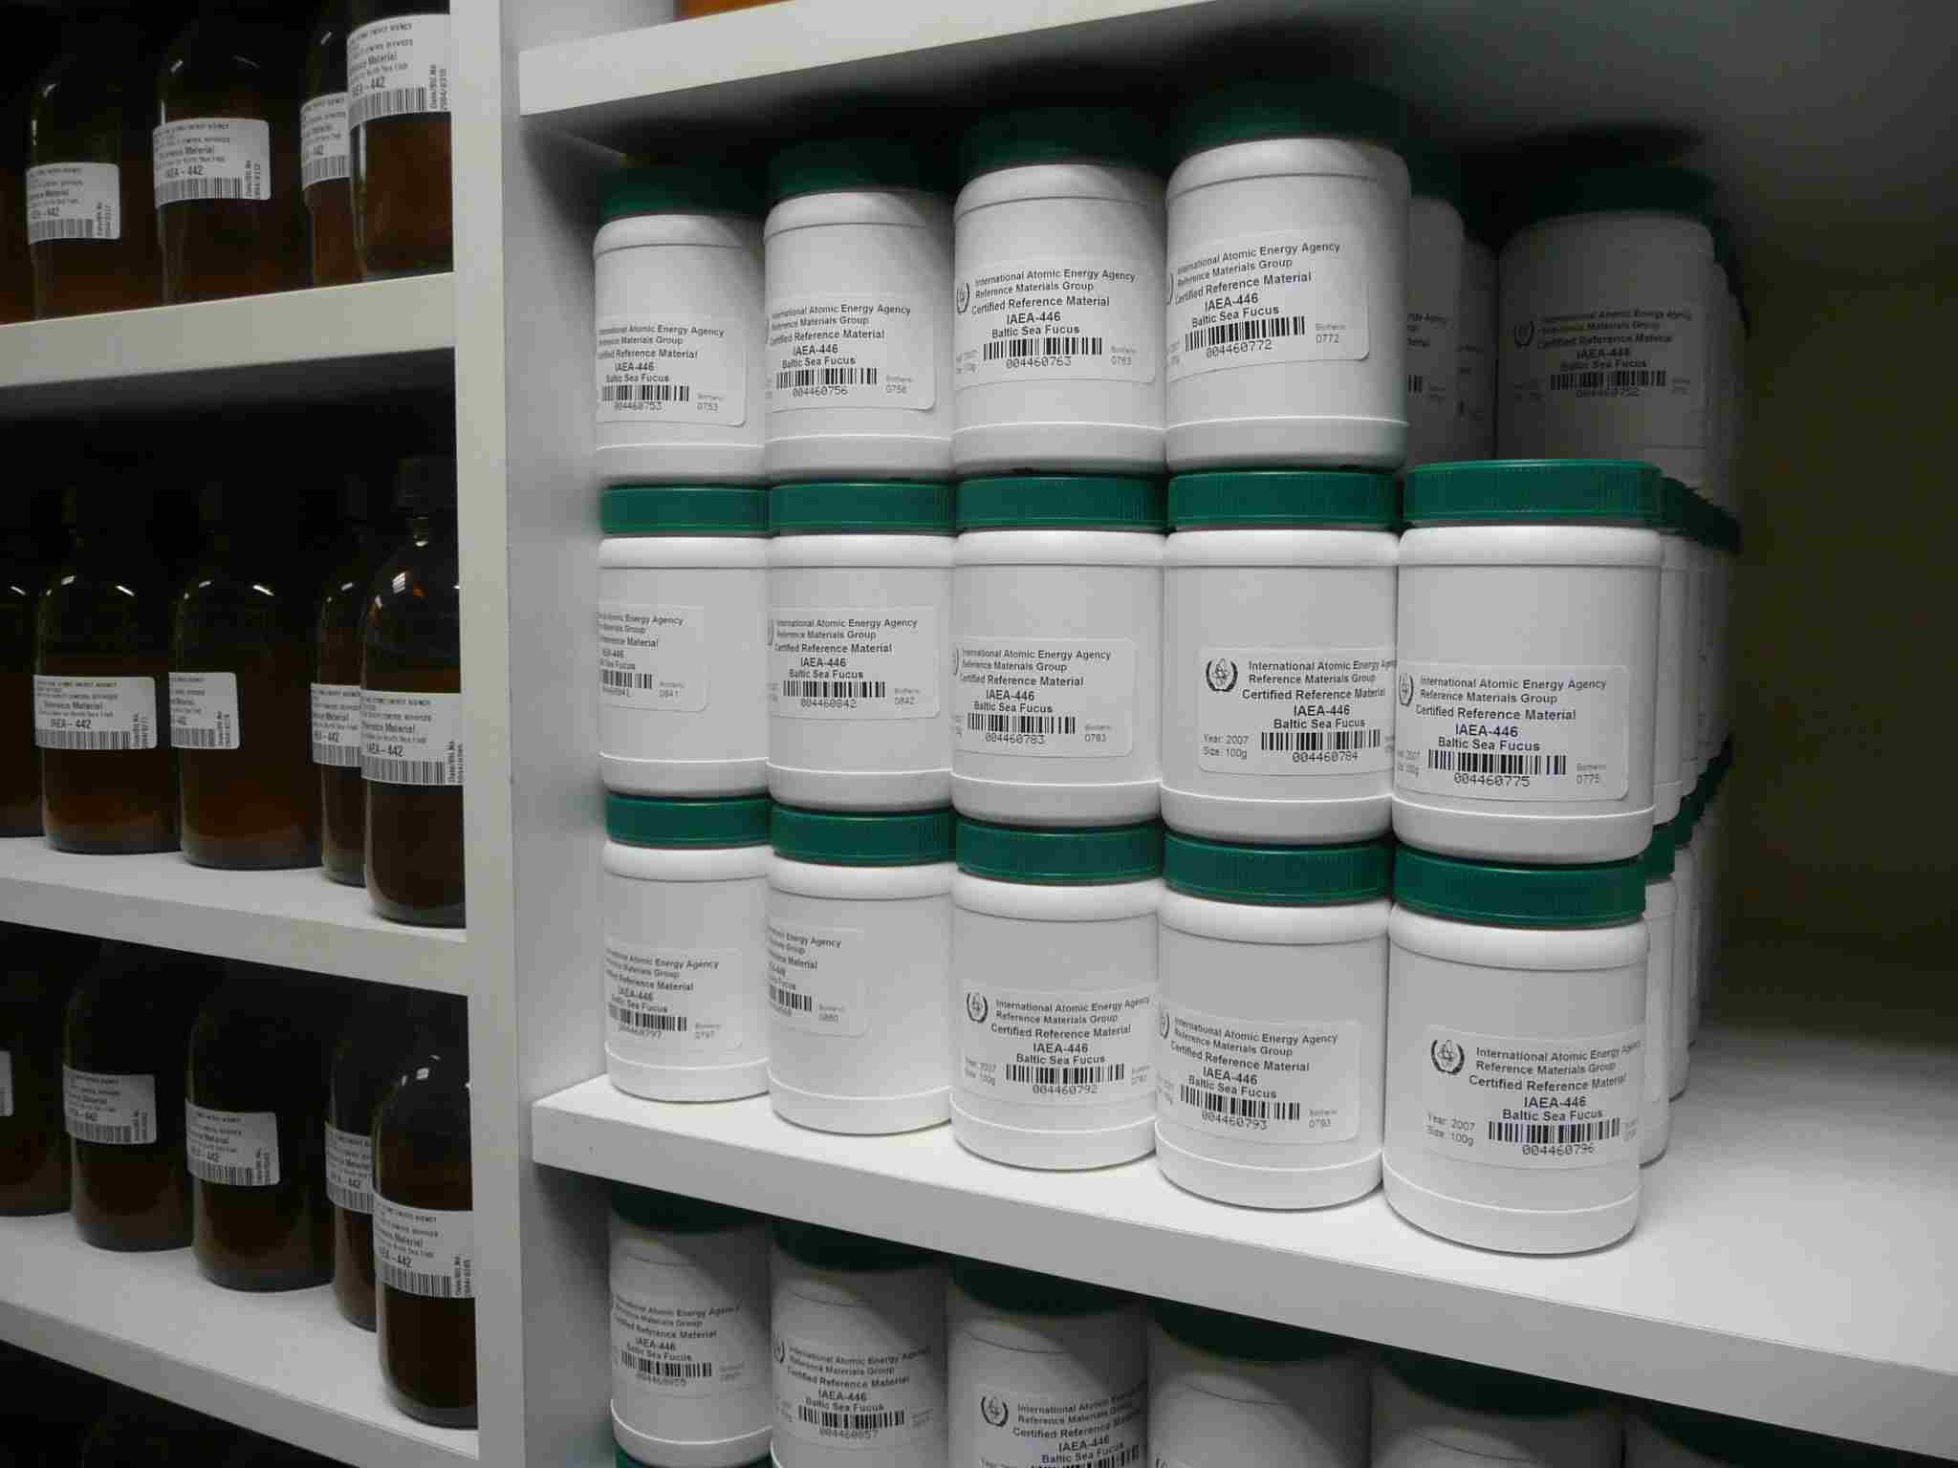
Provision of Reference Products for Science and Trade

Slide 18
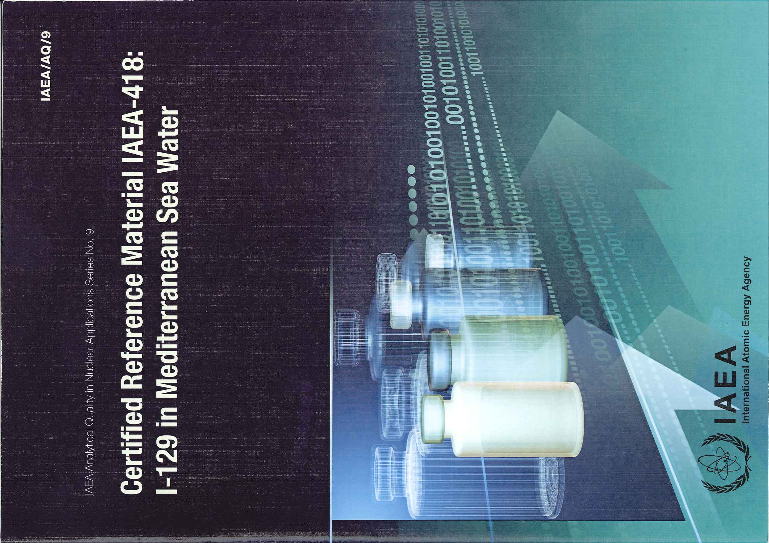
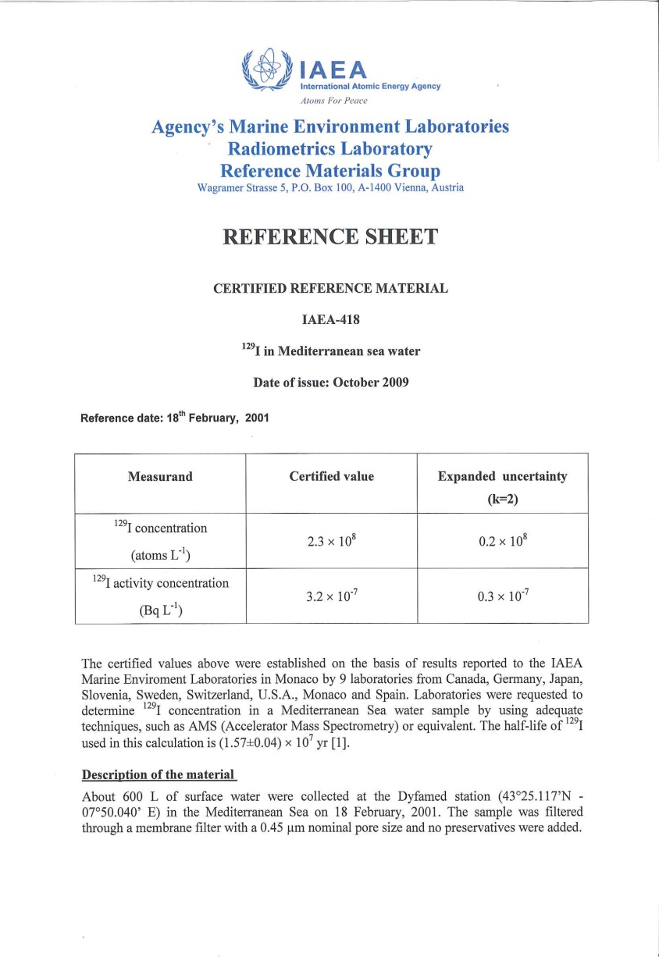

Slide 19
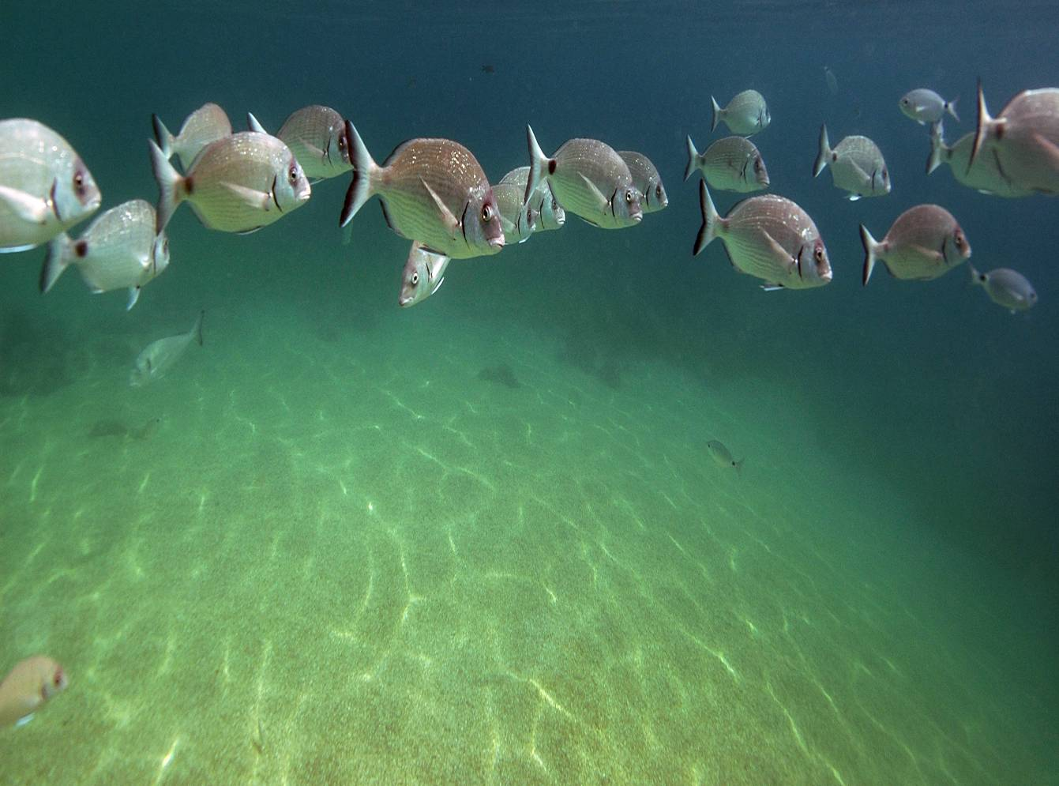
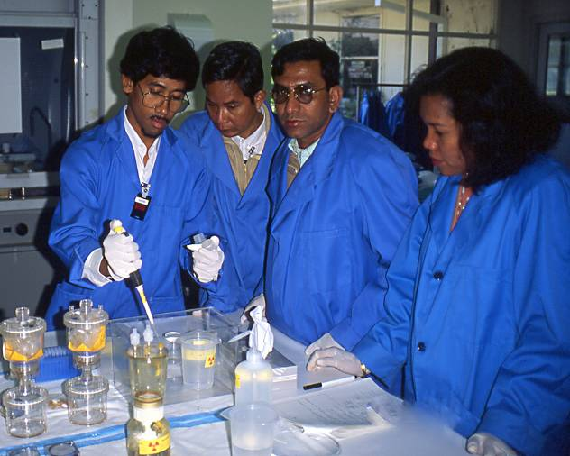
Radiological techniques for seafood safety
Training IAEA member states in tracer studies of uptake of contaminants in fish
5
Turbot
4
3
¹³⁴Cs Uptake
2
Shark
1
0
0
5
10
15
days

Slide 20
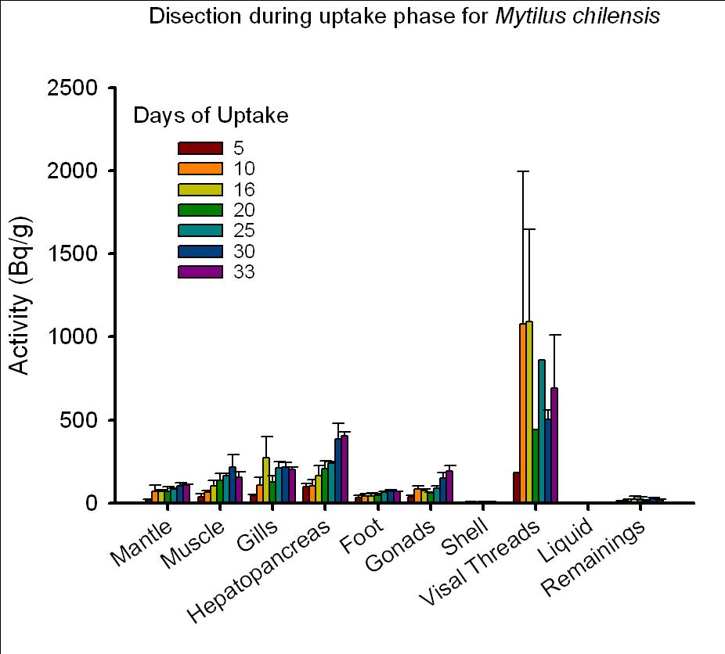
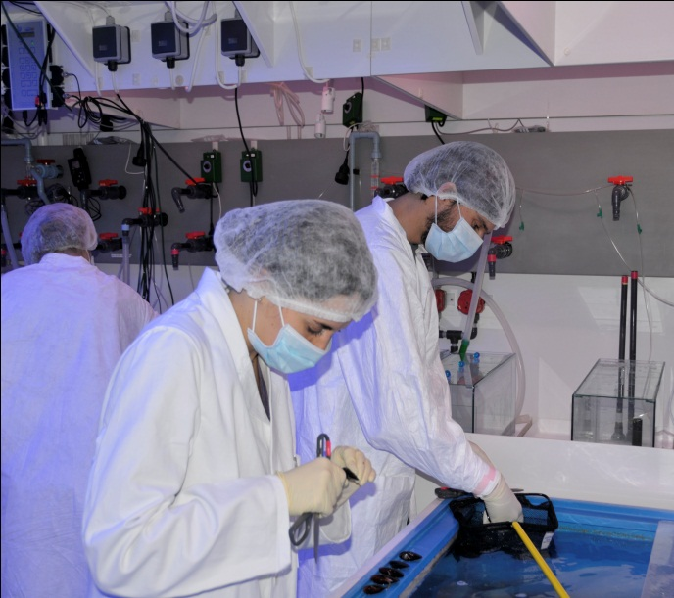
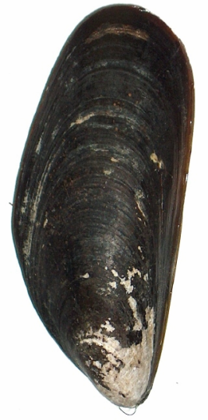
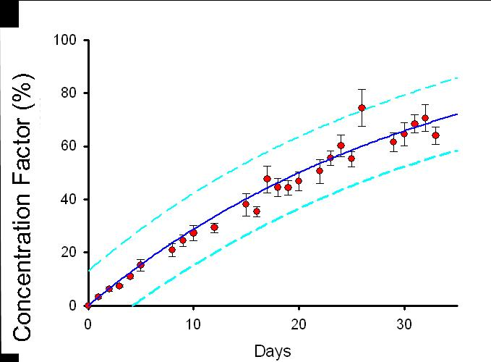
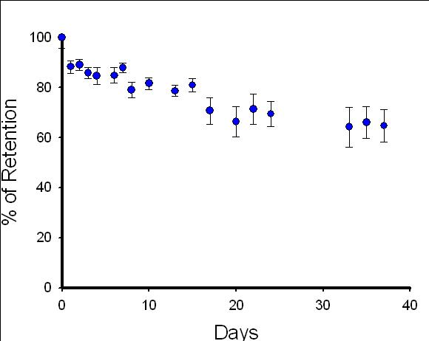
Uptake of Cadmium (Chile)
¹⁰⁹Cd
Depuration
Accumulation
Notes:
We welcomed a trainee student from chile, who brought some Chilean mussels.
By using a fantastic tool, which is the radiotracer, we determined for these chilean mussels how they incorporate the Cd via the dissolved way, how long they need to be saturated in Cd (in this exp they never really stop to accumulate Cd even after 1 month of exp). For that we used the radiotracer 109Cd. We look at which organ accumulate the most?
We also determined how long they need to depurate this Cd, so after the labeling we submitted the mussels to normal seawater and we look at how long they need to lose all their Cd (here really slow depuration process).
After in Chile, this study will reproduce this kind of experiments with other trace elements and other marine organisms.

Slide 21
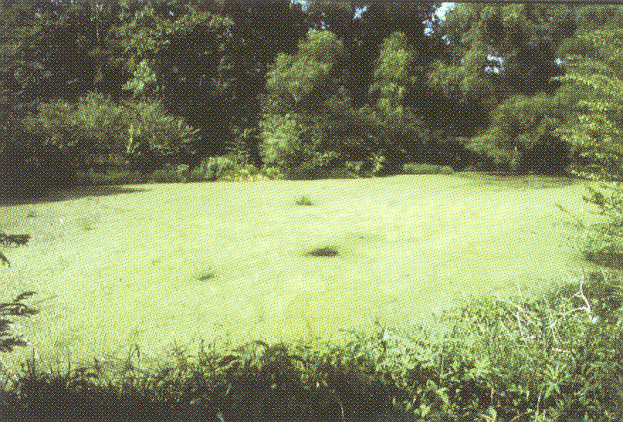
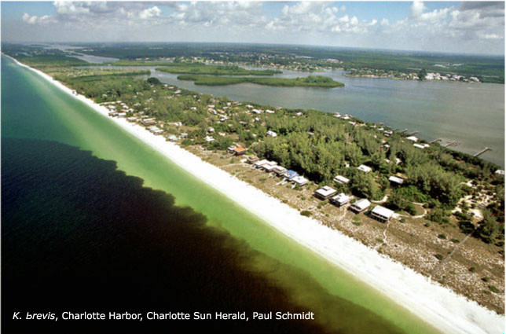
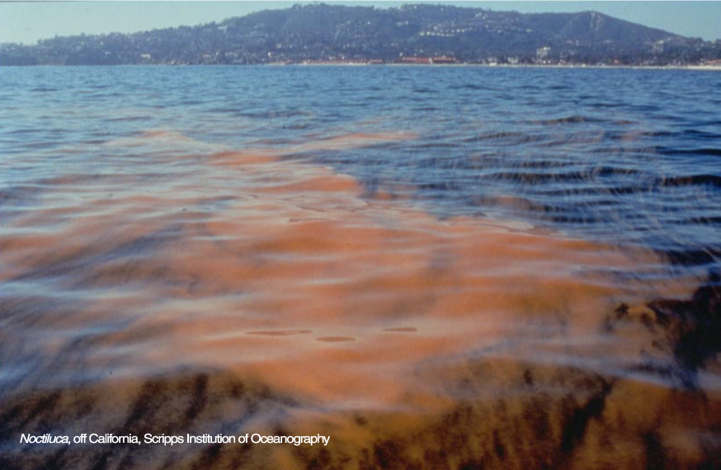

Harmful Algal Blooms
Photo credit: B. Suarez

Slide 22









HABs
    Need to strengthen transfer of knowledge, capacity building
    and studies to understand, predict and reduce the risks of HABs
    Establishment of RBA technology at NAEL
Bloom of toxic algae
Transfer, bioaccumulation and biotransformation
of the natural toxins
Human illness
Beach closure
Fisheries closure
Radioligand RBA for algal toxin monitoring

Slide 23



Slide 24






Ocean acidification
  Geochronology (radiological dating)+ Paleo-climatology (isotopic ratio analysis): powerful tool that allows reconstructing prevailing environmental conditions over last decades to millennia to calibrate and improve descriptive and predictive models
  Environmental recorders:
  - sediment cores
  - coral skeleton
Isotopes used as proxies:
e.g. B-11/B-10 for past pH

Slide 25





Ocean acidification
Unique tools to assess biological effects under projected pCO₂ scenarios, identify vulnerable organisms, evaluate potential coastal economic impacts (fisheries, aquaculture, ecosystem services), e.g.:
  Use of Ca-45 to assess growth and calcification rates
  Use of C-14 to assess primary production of marine phytoplankton
  Use of radio-tracers to assess change in pollutant availability

Slide 26

Climate change related studies
Calcification
Accumulation
Ca
⁴⁵Ca
²⁰³Hg
¹³⁷Cs
⁴⁵Ca
¹⁰⁹Cd
²⁴¹Am
Ca
Ca
⁴⁵Ca
Use of radiotracer (ß-emitter) to measure impact of OA on calcifiers
Use of radiotracer (γ-emitter) to measure impact of OA on pollutants availability
Production of commercial species (mussel, oyster, sea urchin, squid,…)
High-value ecosystem such as coral reefs (high biodiversity, tourism,…)
Possible toxic impact on organisms
Concentration in seafood for human risk assessment

Slide 27


Slide 28



Slide 29

Ocean acidification
Analysis of Arctic Ocean Acidification in 3 coupled climate - carbon cycle models
  undersaturation occurs first in the Arctic;
  waters become corrosive to all forms of CaCO₃ by the end of the century

Slide 30






Acidification will change marine ecosystems
Synthesis of existing experimental studies
Organisms react differently
Corals and shell builders decline
Seagrasses may increase
Fish become disoriented
Prey loss affects predators
Potential fish catch decline
Photo: J.-L. Teyssié
Photo: Ana Laangova*
Photos: Jean-Louis Teyssié →
Wittmann & Pörtner (2013, Nature Clim. Change)
see also Kroeker et al. (2013, Glob. Change Biol.)
Notes:
Some species will be affected, others not, others will benefit

Slide 31

If you or I were a marine organism
in a high CO₂ world?
Notes:
Healthy human living under the sea

Slide 32

Early stages of life ?
Notes:
The effects of ocean acidification can be seen most keenly during the early stages of life. A decrease of 0.2 unit pH causes 100% mortality 8 days post fertilization in calcifying larvae of the common brittle star (similar to a starfish) (Dupont & Havenhand, 2008). Predicted ocean acidification within the next 50-100 years will at the least cause severe reductions in larval survival and at worst eradicate some species with less chance of adaptation (Dupont & Thorndyke, 2009).

Slide 33

Impaired sensory capacity
Notes:
Ocean acidification has been seen to have an impacts on a wide variety of sensory capacities including olfactory, auditory and visual. A study showed that reef fish exposed to ocean acidification lost their sensorial responses (olfactory and auditory) and therefore ability to identify predators and non-predators (Castro, 2014).

Slide 34

?
Behaviour
Impaired
sensory capacity
Notes:
Behaviour of marine organisms is largely altered by increasing ocean acidification as a result of an impairment or change in sensory capacities. Studies have demonstrated significant impacts of anthropogenic acidification on olfactory abilities in particular leading to changes in behavioural responses with potentially far reaching impacts on population dynamics and community structure (Antoine et al, 2013). Hamilton et al (2013) discovered a significant increase in anxiety of rockfish under CO2-induced ocean acidification (pH7.75) and were found to remain anxious up to 7 days whilst back in control waters.

Slide 35
?
Behaviour
Reproduction?
Impaired
sensory capacity
Notes:
Fertilisation in benthic marine invertebrates decreases when exposed to CO₂ induced ocean acidification. For example sea urchins have been shown to suffer a 44% decrease in fertilisation success when exposed to higher levels of ocean acidifications due to a lower percent of motile sperm (Schlegel et al, 2012) .

Slide 36

?
Behaviour
Weakened skeleton or shell
Impaired
sensory capacity
Reproduction
Notes:
Most calcifying marine organisms studied to date show a decrease in calcification or shell weight in response to elevated CO2 and reduced pH and it is one of the most well documented physiological effects of ocean acidification. For example in many species of Molluscs a weakening, and thinning of shells has been observed as a result of ocean acidification.

Slide 37

?
Behaviour
Weakened skeleton or shell
Impaired
sensory capacity
Reproduction
Immunity and disease issues
Notes:
Studies have shown that whilst some organisms are able to acclimatise to an increase in seawater pH this acclimatisation may come at the cost of other physiological processes such as immune function. A study by Ellisa et al, (2014) showed that a 90 day exposure to decreased pH conditions led to a significant reduction in antibacterial activity within the blue mussel mytilus edulis.

Slide 38
?
Behaviour
Growth rate
Weakened skeleton or and shell
Impaired
sensory capacity
Reproduction
Immunity and disease issues
Notes:
Studies show that many benthic species have lower growth rates under projected higher levels of acidification, this is particularly true in the case of coral and molluscs. Molluscs have been observed to have a strong and statistically significant decrease in growth rates at lower pH values, with virtually no growth at pH = 6.7 and reduced growth at pH = 7.1 (Berge et al,2006).

Slide 39
Impediments to ecosystem resilience
Limited genetic diversity
Reduced resilience &
smaller evolutionary potential
Reduced populations

Slide 40



Economic and social impacts
Ocean acidification will affect various ecosystem services including: aquaculture, fisheries, marine tourism, seafood security, coastal protection and human livelihoods
Oyster Farms
Coral Reefs
Food Webs

Slide 41

The Future We Want?
$
???
$
pH = 8.1
pH = 7.8 to 8.0
pH < 7.7
Images from coastal area near Papua New Guinea at natural CO₂ venting from the sediment (Fabricius et al, 2011 Nature Climate Change)

Slide 42



“OUR OCEAN” CONFERENCE, WASHINGTON, 16-17 JUNE 2014
“And while the pH of ocean water may vary slightly from one place to another, rising levels of ocean acidification threaten ocean ecology everywhere. Along with the atmosphere, our ocean is the greatest of all of our shared assets. “
Secretary John Kerry
.

Slide 43




Peaceful Uses

Slide 44




Technical Cooperation & Capacity Building
Notes:
44
A travers le programme de coopération technique de l’AIEA, le LEM appuie la mise en place d’une capacité essentielle dans les Etats Membres en développement grâce a la recherche appliquée sur l’environnement marin.
Les sujets couverts comprennent la radioactivité et la radioécologie marines, la radiochimie et l’évaluation de la pollution marine. Le LEM accueille aussi chaque année des douzaines de stagiaires en provenance de pays en développement qui viennent travailler au laboratoire de Monaco pour renforcer leur compétences et leurs connaissances scientifiques.

Slide 45


Thank you

